Slide 1
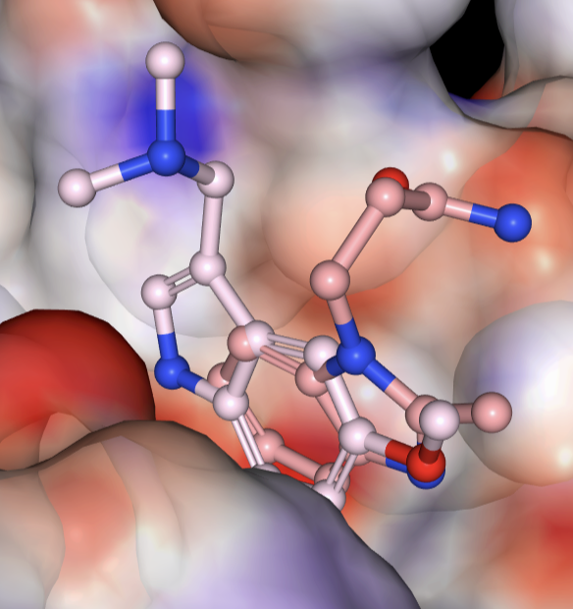
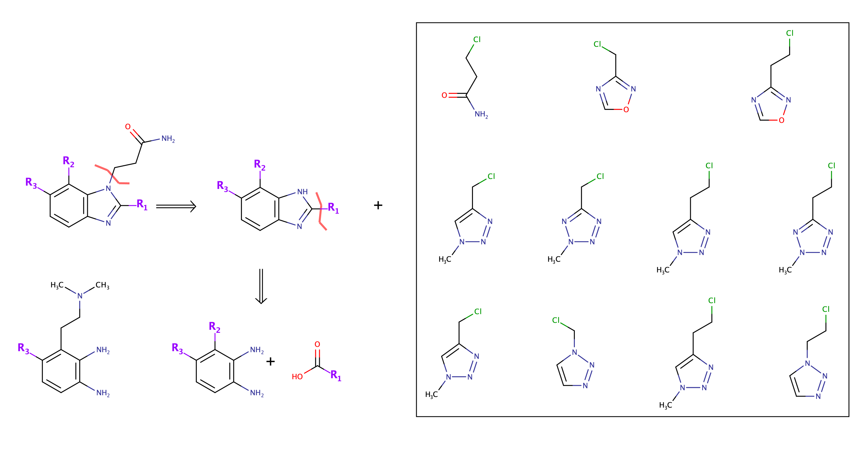
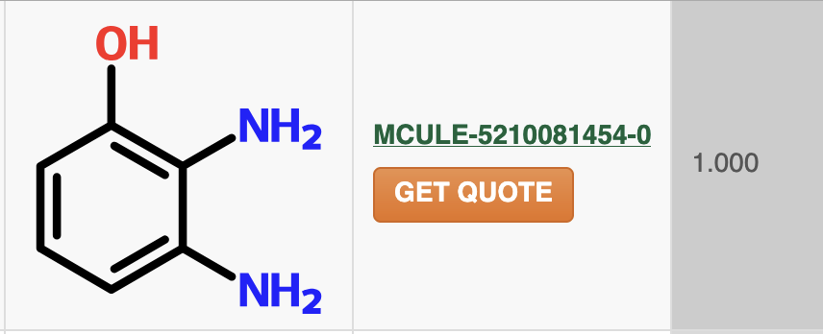
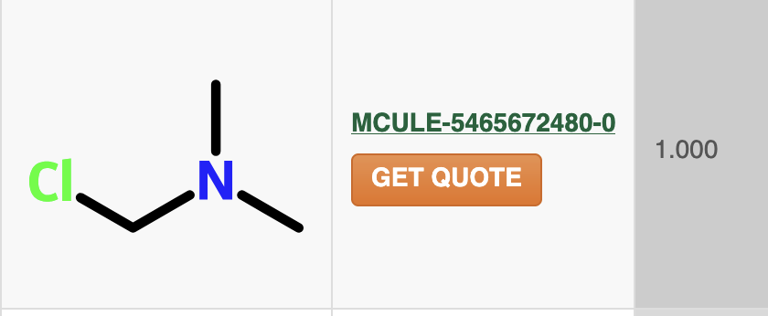

A0229 almost complete merge with A0503
Elaborate using heterocycle chem core, Williamson ether and nucleophilic sub chem (The full hog left/right exploration)
Swap A0029 carbon for oxygen for more vector options
Heterocycle synthesis => diverse R2 and R3 more likely
Suzuki => very limited R2 and R3 groups
Isosteres for amide grou
https://pubs.acs.org/doi/10.1021/acsmedchemlett.4c00591?articleRef=test

Slide 2
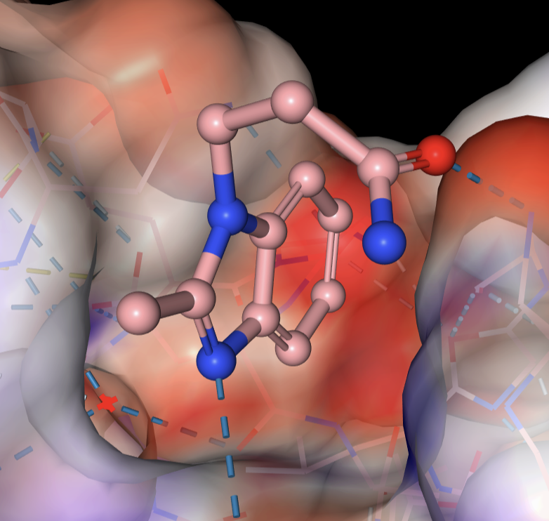
A0503 elaboration using heterocycle synthesis and nucleophilic subs
8-postion of benzimidazole ring elaborated with carboxylic acid analogues
Heterocycle synthesis => diverse R2 and R3 more likely
Suzuki => very limited R2 and R3 groups
Isosteres for amide group
https://pubs.acs.org/doi/10.1021/acsmedchemlett.4c00591?articleRef=test

Slide 3
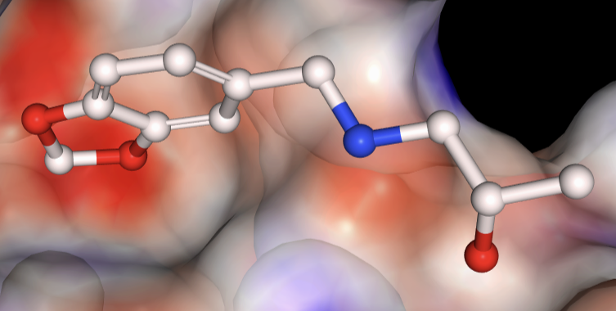
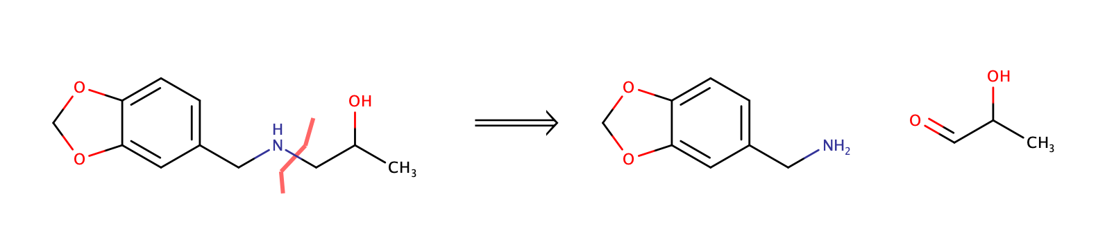
A0759 elaboration using reductive amination

Slide 4
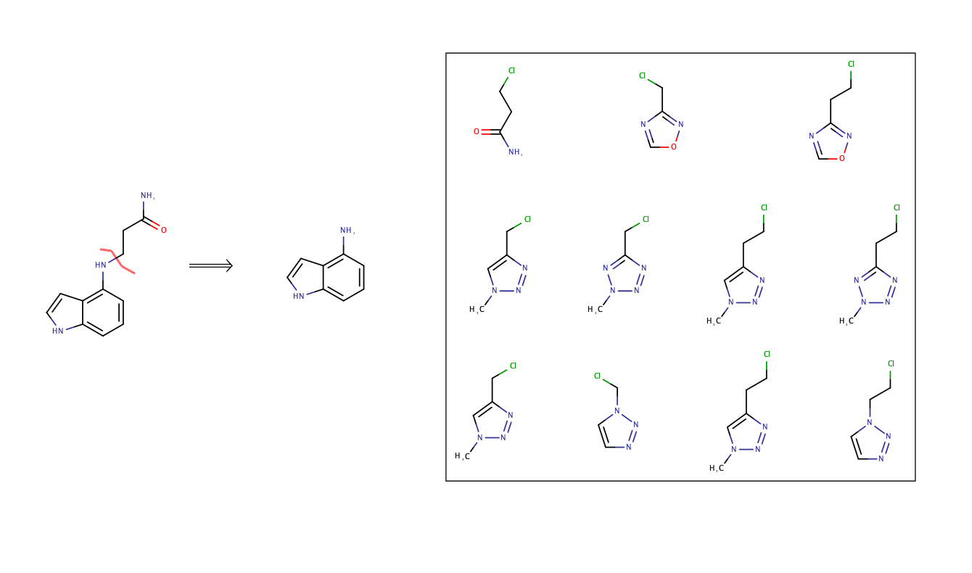

A0229 partial merge with A0503 elaboration using Nucleophilic subs

Slide 5
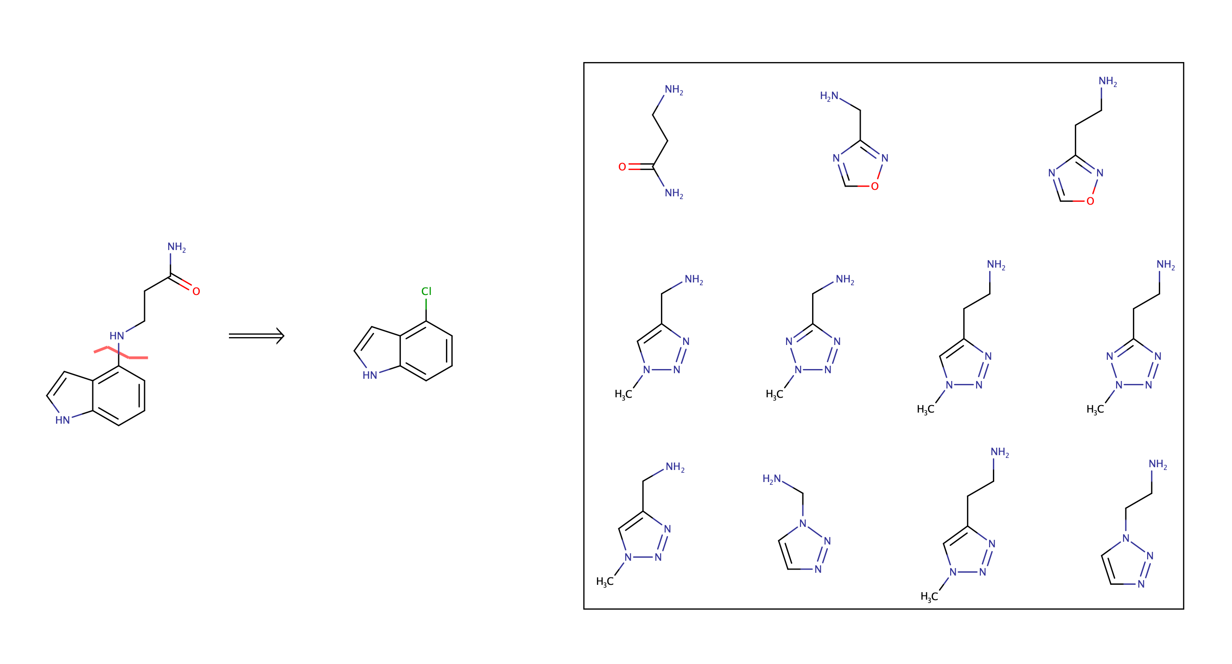
A0229 partial merge with A0503 elaboration using Buchwald Hartwig

Slide 6
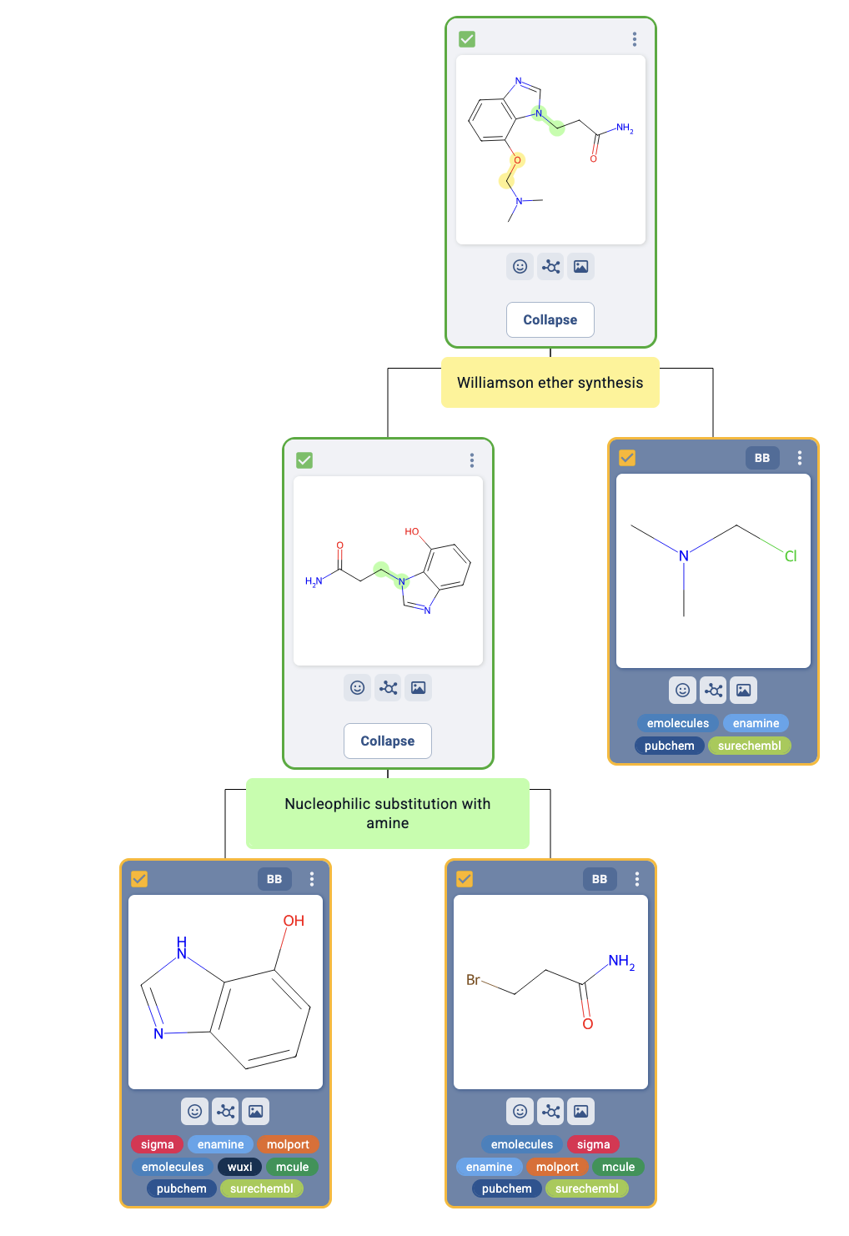

A0229 partial merge with A0503 elaboration using Williamson ether and nucleophilic sub chem

